Slide 1



LJ Institute Of Engineering And Technology
FairPlayAI - AI Bias & Fairness Checker
NAME : SATVIK PARIHAR
ENROLLMENT NO : 23002170510039
BRANCH : AIDS
BATCH : A1
ROLL NO : 4
NAME : MASRANI KASAK ATULBHAI
ENROLLMENT NO : 23002170110083
BRANCH : CE
BATCH : A1
ROLL NO : 6
NAME : PATEL KHUSHI NARENDRAKUMAR
ENROLLMENT NO : 23002170110126
BRANCH : CE
BATCH : A1
ROLL NO : 13
Notes:
‹#›

Slide 2
Agenda
Navigating Bias: Our Journey
1
Introduction to FairPlayAI
2
Data Handling & Preprocessing
Understanding the platform's core mission and capabilities.
How FairPlayAI ingests and prepares user data.
3
Model Training & Evaluation
4
Reporting & Future Vision
The machine learning lifecycle within the platform.
Delivering insights and charting the path forward.
Notes:
‹#›

Slide 3


Introduction
FairPlayAI is a user-friendly web platform designed to detect, analyze, and
reduce bias in machine learning models. Users can upload datasets, clean
data, train classification or regression models, and access detailed
performance and fairness reports.
The platform simplifies the machine learning process, making fairness analysis accessible even to non-experts. FairPlayAI supports users from all backgrounds in building more ethical, reliable, and transparent AI systems.
Notes:
‹#›

Slide 4


Problem Types
Versatile ML Problem Solving
FairPlayAI is an automated ML tool that takes your data and automatically decides whether to use classification or regression, based on what you're trying to predict—so you don’t need to manually select the type of model.
Classification
Regression
For scenarios involving categorical target variables, FairPlayAI automatically configures for classification tasks, predicting discrete outcomes.
When dealing with continuous target variables, the system adapts to regression problems, forecasting numerical values.
Models used:
Models used:
Linear Regression
Logistic Regression
2.Polynomial Regression
2.K-Nearest Neighbors (KNN)
3.Decision Tree
4.Random Forest
Notes:
‹#›

Slide 5
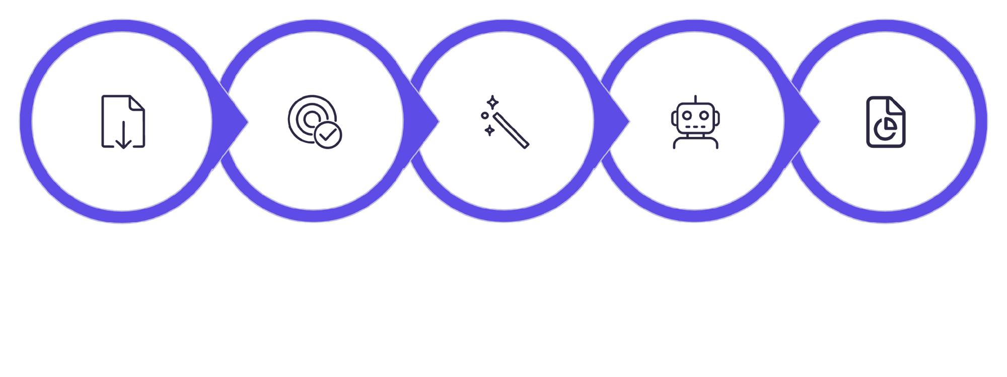





Model Training Workflow
From Raw Data to Trained Insights
Train Model Or custom model upload
Select Features and Target
Preprocess Data
Upload CSV
Report
The training process includes data splitting (typically 80/20 train/test split) and robust evaluation on the test set. For enhanced validation, cross-validation techniques may be employed.
Notes:
‹#›

Slide 6
Evaluation Metrics
Comprehensive Performance & Fairness
Classification Metrics
Regression Metrics
Accuracy: Overall correctness of predictions.
MAE (Mean Absolute Error): Measures the average magnitude of errors, giving equal weight to all errors.
Demographic Parity: Assesses whether positive prediction rates are equal across different groups.
MSE (Mean Squared Error): Averages the squared differences between predicted and actual values, emphasizing larger errors.
Equalized Odds: Checks if both true positive and false positive rates are equal across groups.
R² Score (Coefficient of Determination): Indicates how well the model explains the variability of the target variable.
Calibration: Evaluates how well predicted probabilities reflect actual outcomes.
Individual Fairness: Ensures similar individuals receive similar predictions.
Crucially, every report generated by FairPlayAI integrates bias detection and fairness analysis, providing a holistic view of model performance and ethical implications.
Notes:
‹#›

Slide 7
Results and Reports
Actionable Insights from Your Models
Upon completion of model training, FairPlayAI presents clear, concise performance metrics (e.g., accuracy: 0.92, F1-score: 0.89). Beyond raw numbers, the platform generates comprehensive analysis reports that are securely stored in a MongoDB instance.
"Model achieved 92% accuracy with no significant bias detected across gender groups."
These reports encapsulate not only model performance but also critical fairness analysis and a detailed data cleaning summary, offering a complete narrative of your model's behavior and ethical standing.
Notes:
‹#›

Slide 8



Conclusion & Future Work
Towards a Fairer AI Future
Enhanced Data Visualization
Developing more interactive and insightful visualization tools for deeper data exploration and interpretability.
More ML Models
Expanding our library of supported machine learning algorithms to offer greater flexibility and choice.
Advanced Fairness Metrics
Integrating sophisticated metrics and techniques for even more nuanced bias detection and mitigation.
FairPlayAI streamlines the entire ML workflow from data upload to fairness reporting, empowering users to proactively identify and address bias in their models, paving the way for more responsible AI development.
Notes:
‹#›

Slide 9
Thank You!
Any Question?
Notes:
‹#›

